Slide 1
Readers Wanted!
Getting Your Students to Complete the Assigned Course Readings

Slide 2
Entrance Ticket
You have 5 minutes to complete the Entrance Ticket you’ve been provided.
When it has been completed, please hold your ticket up so one of us can collect it.
We will revisit this Entrance Ticket later in the presentation.

Slide 3
Overview of the Survey
Surveyed 137 IRSC students
Completed 97 surveys
Covered all campuses
70.4% full time students, 29.6% part time students
66.3% declared Associate’s, 27.6% declared Bachelor’s
70.1% read daily

Slide 4
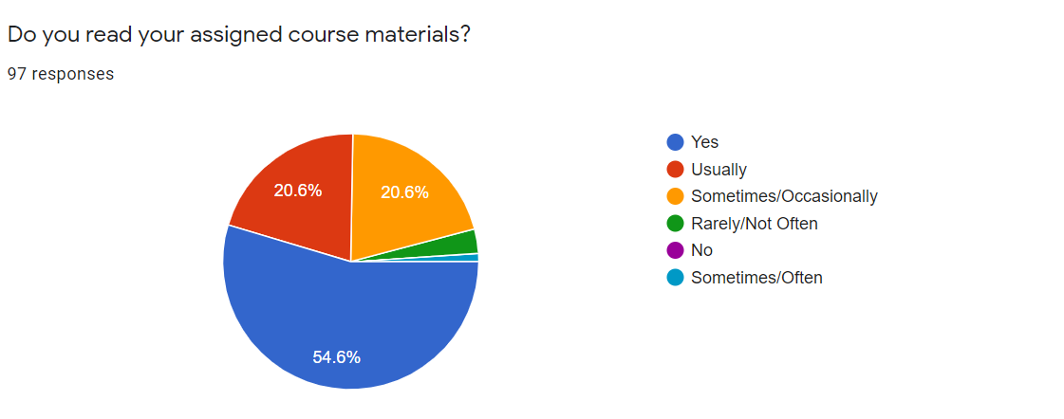
Finding: Students don’t always read course materials.
54% of students reported that they always read
their assigned course materials.
46% do not always read their course materials.

Slide 5
Strategy 1: Guided notes for frontloading
The purpose of Guided Notes:
Focus on specific sections of the reading.
Guided notes taken for a grade can help motivate students to do the reading.
Students are better prepared for class discussions.
Guided Notes as homework:
Assign guided notes on some or all readings.
Use guided notes as a grade.
Students can bring guided notes to class.
Students can also turn guided notes into Blackboard.
Instructor asks questions from guided notes during class.
Many questions can be opinion based.

Slide 6
Strategy 2: Entrance tickets
The purpose of the Entrance ticket:
Focus on the topic for that class.
Check for understanding of the assigned reading.
Review concepts in assigned reading.
Quickly diagnose student understanding
Entrance Ticket parameters:
Completed at the start of class.
Timed, about 5 minutes
Instructor quickly reviews responses before instruction.
Or uses to begin discussion, reviews specific answers after class.

Slide 7
Entrance Ticket Example
What percentage of your students would you say come to class having read the assigned reading?
What percentage of your students complain that there is too much reading?
What percentage of your students struggle to understand what they read in your class?

Slide 8
Strategy 3: Padlet
The purpose of Padlet:
Students complete assigned reading and comment on one of the following:
A question about the reading
A comment about the reading
Something interesting about the reading
A connection with the reading
Padlet’s taken for a grade can help motivate students to start and complete reading.
Students are better prepared for class discussions.
Padlet as homework:
Assign a Padlet response on some or all readings.
Instructor uses Padlet posts to lead class discussions. (Make them due a day before class.)

Slide 9
Finding: There are strategies instructors are currently using that students identified as being helpful for reading comprehension.
Survey Question: Are there instructional practices or strategies your instructors use that aid your understanding of assigned readings?
Student Responses:
-Yes, we get study guides
-Completes guided practice questions to use while reading (counts as grade)
-Yes, highlighting important stuff
-She goes over new words and
gives us outlines and study guides
-Step by step instructions on what to read
-Instructor doesn't assign the entire chapter (assigns specific pages); instructor tells class to focus on specific parts of the chapter
-Outlines
-Giving us a layout of lesson and having us take notes
-Yes, guided notes which list the topics and we just fill in the blanks

Slide 10
Strategy 1: Selective reading assignments
Jigsaw Reading Strategy
Jigsaw is a strategy that emphasizes cooperative learning by providing students an opportunity to actively help each other build comprehension.
Assign selective course readings/chapters prior to class
Provide groups with set of guiding questions/notes
Group becomes the expert to teach to rest of class
Provide class with full set of guiding questions/notes from all groups to assist with note-taking

Slide 11
Example Jigsaw Guided notes

Slide 12
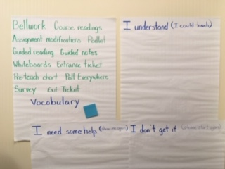
Strategy 2: Review vocabulary
Review with Charts
Identify essential terms and concepts
Provide sticky notes and list of terms
Students post to charts prior to lesson (Bellwork)

Slide 13
Review Chart Example for Vocabulary
Bellwork
Selective reading
Padlet
Guided notes
Poll Everywhere
Review chart
Exit Tickets

Slide 14
Finding: Students do not believe that reading more will help their understanding.
Survey Question:
Do you feel if you read more it will help you get a better/deeper understanding of the assigned materials? Why or why not?
Answer:100% No

Slide 15
Strategy 1: Pre-teach exit ticket using Padlet
Pre-teach using Padlet
Instructor will identify words that may be challenging from an upcoming reading passage
Instructor will present these words to the class.
Class will use Padlet to identify which words they do not know, or do not know well.
Instructor will then pre-teach the meaning of these words, before the students leave and start the reading.

Slide 16
Strategy 2: Pre-teach exit ticket using whiteboards
Pre-Teach with White Boards
Provide question
Students respond on whiteboard
Try individual, partners, or small groups
Make your own whiteboards

Slide 17
Pre-Teach White Board Example
Ice cream was traditionally sold in half-gallon containers, which contained 64 ounces. Then several ice cream makers decreased the size of the containers to 56 ounces. Later, containers were again decreased to 48 ounces. The price remained the same at $3.99 per container. By what percent did the price effectively increase with each change in package size?
Size in ounces | Cost | Cost per ounce | % increase
64 | $3.99 | $0.62 | ----
56 | $3.99 | $0.71
48 | $3.99 | $0.83

Slide 18
Strategy 1: Pre-teach exit ticket using Poll Everywhere
Pre-teach with Poll Everywhere
Students use their phones to take the poll and results are shown in real-time.
The poll questions can be created as multiple-choice questions, word cloud of student responses, Q&A (students respond to a question then upvote or downvote other answers), open-ended, competitions (where speed counts), and more.
Instructors can group questions to create a survey of several questions.

